Slide 1
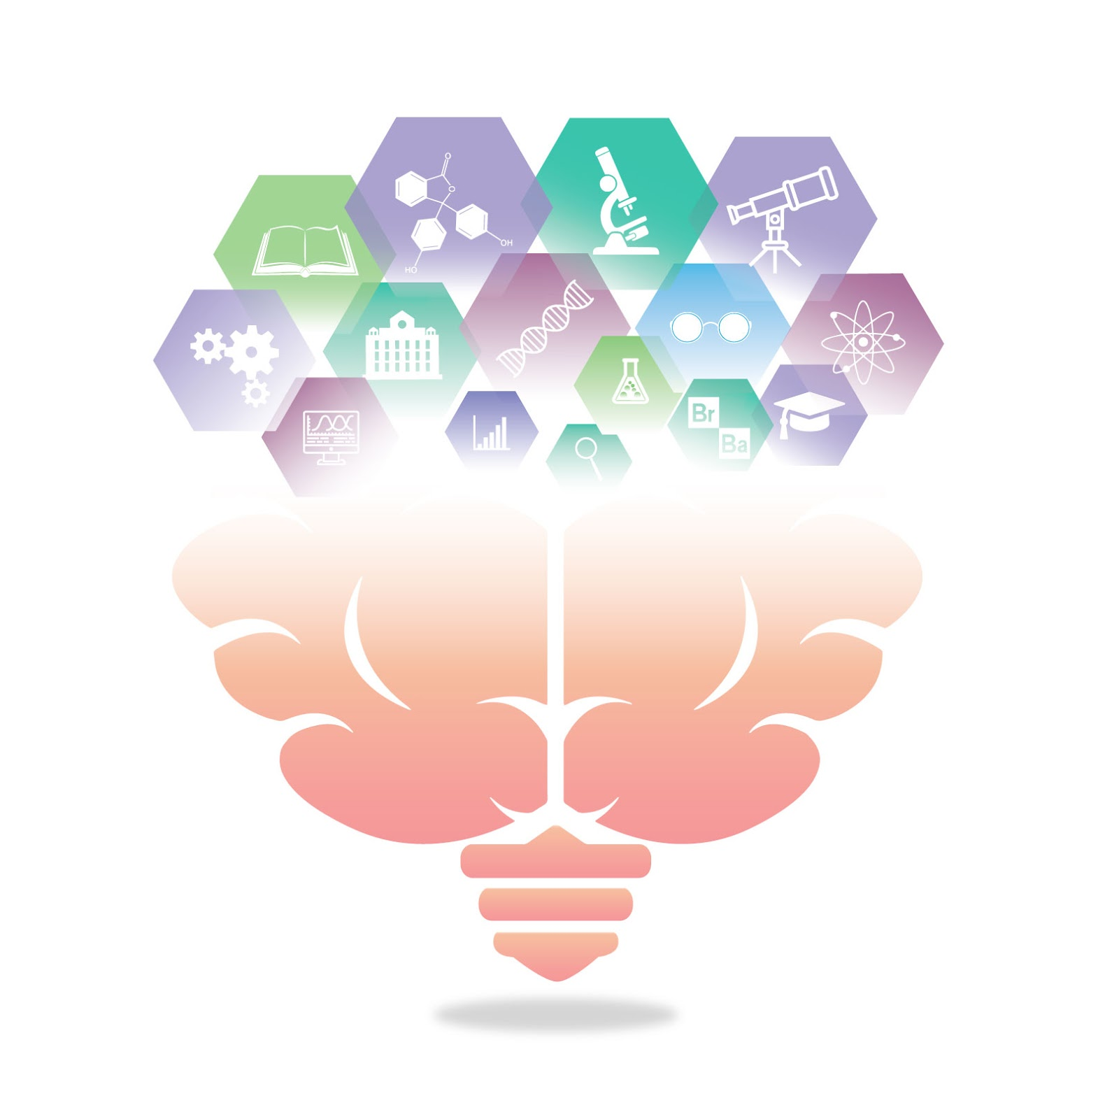
Introduction to open science
Open science student support group
Oct. 9, 2020
Gwen Van der Wijk
Image by Adam Douglas

Slide 2

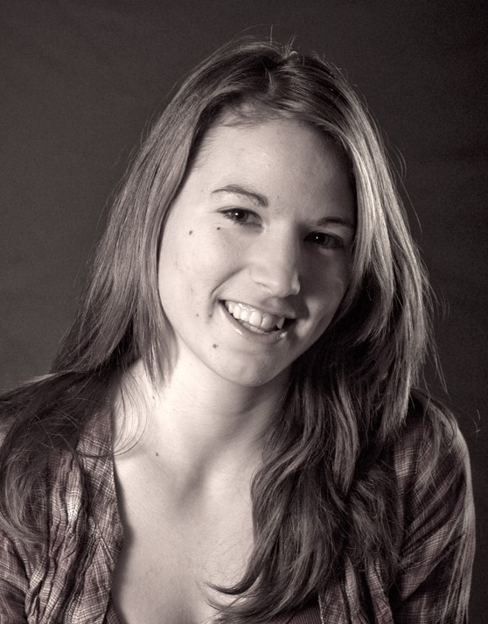
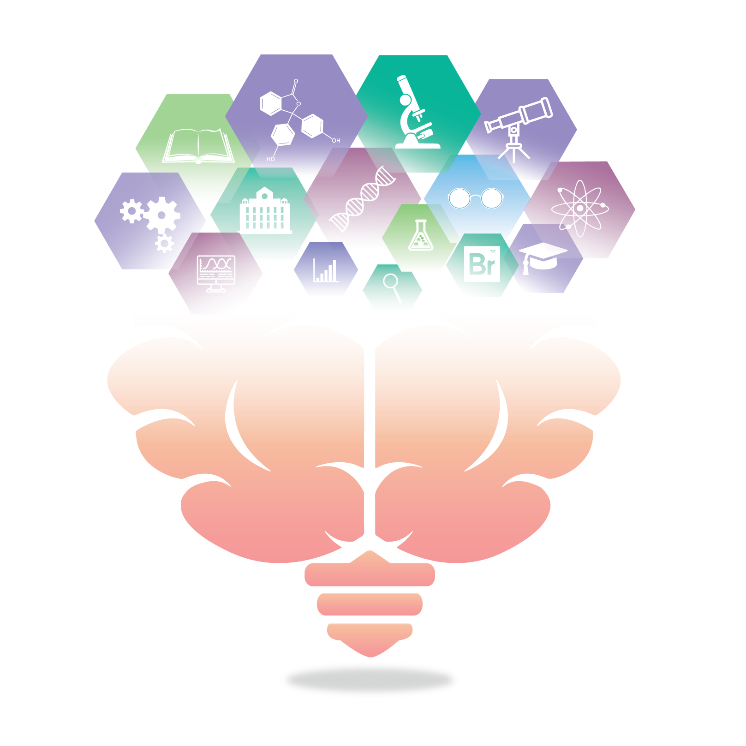
Gwen (She/they)
Dutch/Hungarian – biking, reading, puzzles
3rd year PhD student with Dr. Andrea Protzner (Brain dynamics lab)
Neuroimaging research on major depressive disorder
Running into issues/frustrations
Not an expert on Open Science
Support group: vulnerability, humility, support
Notes:
I’ve heard/learned and been excited about open science since my bachelor, but so far I have done very little to actually implement a lot of the ideas and practices in my own work, and so this summer, running into issues and frustrations in my work, both due to pressure from the existing culture to, for example shorten my methods sections, and from me just using suboptimal practices and finding myself not knowing what/why I did specific things earlier in my projects, then being reminded of the existence and importance of open science, I decided it was time to do something about it. I’m not an expert on open science, which is why I initiated this as a support group, where I hope we can learn from and support each other in the dealing with the frustrations and issues we face in a vulnerable, humble and mutually supportive way, and find better ways to address them using open science practices.
Questions at the end ~ 120 sec

Slide 3
What is open science?
Transparency
Accessibility
Inclusivity
Reproducibility
Reliability
Credibility
Collaboration
“Open Science is just good science” - Tennant, 2018
Image by 지우 황 under a CC BY 2.0 license
Notes:
Open science means different things
Umbrella terms for practices/goals of making science more ….
If these values sound familiar and you’re thinking: isn’t this exactly what regular science is supposed to be about, I’d say yes, as Jon Tennant says in one of his presentations: Open science is just good science
~ 40 sec

Slide 4
Why we need open science
“The Open Science Movement developed in response to the culture of secrecy and skepticism that has been pervasive throughout scientific research.”
Kathawalla et al., 2019, p3
Notes:
So in that case, why do we need open science? Well, as in many situations, theoretical values and actual practice can greatly diverge, as this quote from Kathawalla and colleagues illustrates:
So open science developed in response to some important issues with current research practice that have received increasing attention over the last few decades.
~ 35 sec

Slide 5
Issues in science
Questioning the credibility of science
The replication crisis (only 36% of studies replicated with half the effect size (Nosek et al., 2015))
Questionable research practices & statistical errors/misinterpretation (~50% of articles; Arnheim et al., 2019; Nuijten et al., 2015)
Publishing culture (publication bias, Joober et al., 2012)
Restricted accessibility/paywalls to science
~75% of articles are behind paywalls (~30-40% profit margins; Larivière et al., 2015; Piwowar et al., 2018)
Slows/restricts advances
Notes:
So what are some of these issues? On the one hand, questions have been raised about the credibility of scientific findings. One major problem is the replication crisis, which refers to researchers repeating experiments exactly as published, but often not finding the same results, despite increasing efforts and big samples. Overall, only about 40% of psychological studies has actually been replicated.
This is likely in part related to questionable research practices, which often revolve around manipulating or tweaking data collection, cleaning and/or analysis until you find a significant effect, and misuse/errors in statistics that allow researchers to find significant effects by chance rather than effects that are truly present.
This is combined with a publishing culture that emphasizes new, sensational findings and ignores negative findings, and puts lots of pressure on researchers to produce a great number of papers, encouraging questionable practices and the publication of fluke findings that cannot be replicated.
Another issue is the accessibility of research. About 75% of all published papers are behind paywalls, meaning that anyone not lucky enough to be part of an institution that is rich enough and willing to pay large subscription fees, cannot access the knowledge that is created through science. If you’d like to hear me rant about how outrageous publishing companies are, please ask me, but the main point here is that these restrictions significantly slow and stand in the way of scientific advance, as even many researchers don’t have access to relevant literature for their own work, let alone the public.
This is really only the top of the iceberg, I’ve put resources at the end if you would like to know more about these and other issues in science, but today I’d like to focus more on the solutions open science has come up with
~ 140 sec

Slide 6
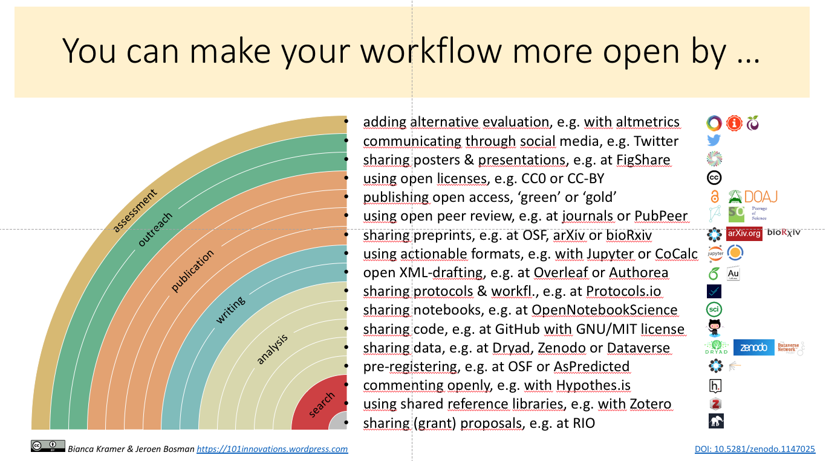
How to: open science
Notes:
Luckily people have already come up with a lot of different ways to address these issues, and have developed all kinds of tools to make it easier for others to start using these practices as well. I won’t go into depth, as talking about all the practices is what we will do in following sessions with this group, but I will give a bit of an overview of the main themes of open science and highlight a couple practices
~ 30 sec

Slide 7
Open access to…
Articles:
Open access journals
Preprints
Data:
Public databases (ethics)
Code/methods:
Open source software
Open Access explained! by PHD Comics (CC BY)
Notes:
The first big, obvious theme is open access, to articles, data, code specific methods and essentially all information related to a project. Open access means materials being available free of charge to everybody, and in the best cases with licenses so they can be easily reused.
There are different ways you can make your articles open access, for example by publishing in open access journals. However, this can be quite pricy for you as an author. A simpler way, which is completely free to both you and readers, is to share your manuscript as a preprint, which is the final version of your paper before you send it in for publication.
Similarly there are tools and practices for sharing data and code, and we’ll go into more depth about sharing data and the ethics involved in just four weeks.
~ 100 sec

Slide 8
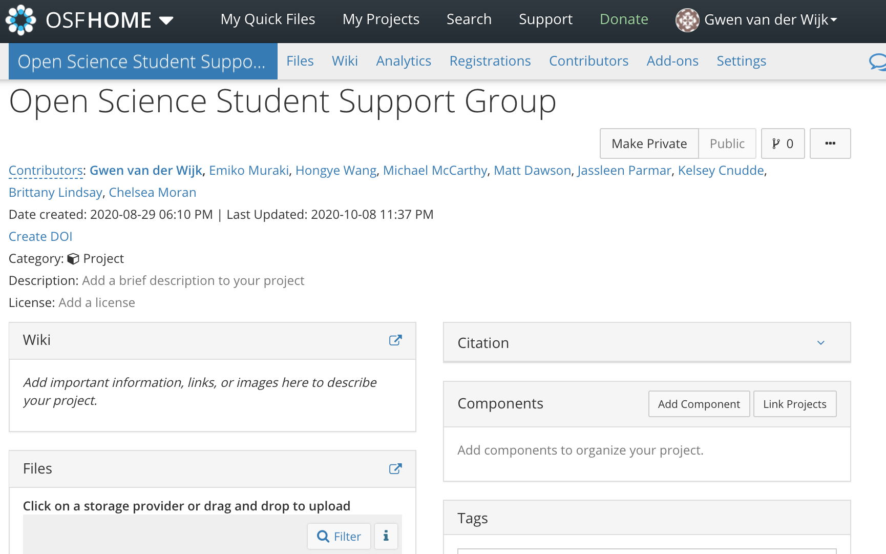
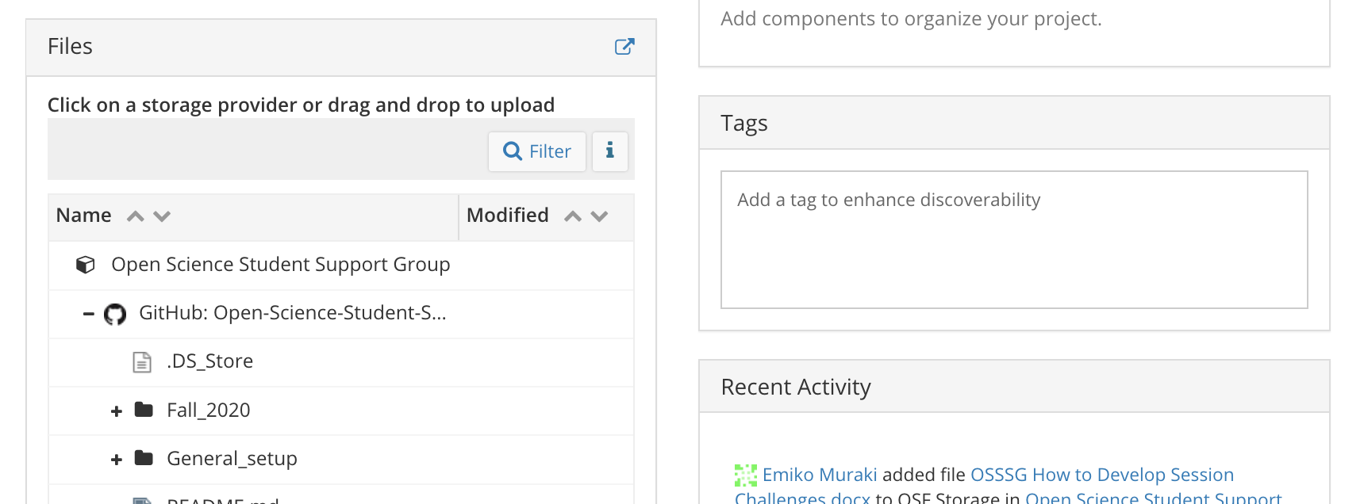
Transparent/robust methods
Project workflow
Preregistration/
registered reports
Open Science Framework
Notes:
Another big theme is transparency and increasing the robustness of methods. Project workflow is about keeping track and organizing your project in a transparent, easy to follow manner. This can foster collaboration, enhance reproducibility and minimize mistakes and biases.
You can also register your reports, which means that you send a detailed plan of your study rationale and methods to a journal before you start your project, they put it through peer review and if they think the project is worthwhile, they tell you to conduct the project which they will then publish whether or not the findings are significant. This shifts the focus from sensational results to proper methods, and prevents a lot of the questionable practices I mentioned before.
The open science framework is a popular tool that can be used for both of these practices. It’s essentially a platform where you can create projects, organize and share your files with collaborators, keep track of progress, and share them publicly, if you want.
We will talk about both of these practices and OSF in more detail in upcoming sessions
~ 120 sec

Slide 9
Open dissemination, discussion and collaboration
Accessible research dissemination
Breaking down existing barriers to participation in science
Direct discussions (e.g. on Twitter, Research Gate, etc.)
Notes:
The third theme I want to highlight is open dissemination, discussion and collaboration.
Most of science is funded publicly, and it is intended to provide solutions and advances to society, so it only makes sense to no only make research findings openly available in their academic format, but also present it to the communities it relates to in an understandable way.
In a similar vain, participation in science should be made more open and accessible, which involves breaking down existing barriers and systemic inequalities that prevent equal participation from people from different parts of the world, different races, genders, abilities, sexual orientations and depending on financial circumstances.
Lastly, science can also be made more open by having more direct discussions in open spaces, for example on Twitter or Research Gate.
I have to admit I know little about these topics, so I’m looking forward to someone with more experience stepping in to give an introduction to them in future sessions.
~ 75 sec

Slide 10
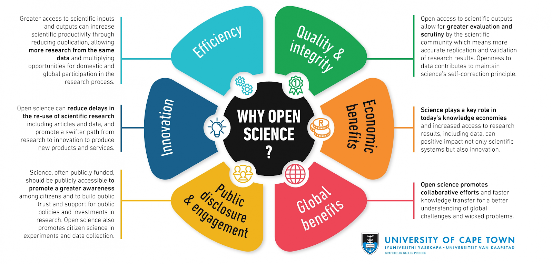
Benefits of open science
This image was created by Gealen Pinnock for the Research Support Hub of the University of Cape Town and is licensed under a Creative Commons Attribution 4.0 International License. This image can be found at http://www.researchsupport.uct.ac.za/why-open-science. No modifications were made.
Notes:
Overall, Open science has a broad range of benefits. Perhaps most importantly, it improves the quality and integrity of research, but it also spurs innovation and efficiency, and aims to foster better communication and interaction with both global and local communities, leading to greater societal impact of research findings and a broader range of perspectives, populations and issues being studied.
~ 30 sec

Slide 11
Benefits for you
Being part of an cooperative global research community
Access to feedback, data, code, collaborators, etc. (Allen & Mehler, 2019)
Great investment in your future (Allen & Mehler, 2019)
Science is on the way to being open
Open science skills transfer to non-academic careers
Open access articles receive 18% more citations (Piwowar et al., 2018)
Greater chance of publishing null findings (Allen & Mehler, 2019)
Notes:
In addition to contributing to better science practices, open science also has benefits for you more directly. For example, open science let’s you be part of a cooperative global research community, which gives you access to feedback, data, code, collaborators and much more
It’s also a great investment in your future. If you stay in academia, it is probably beneficial to start adopting these practices as soon as you can, as we are already moving towards becoming more open. If you don’t stay in academia it can also be a really good investment, as open science skills generally translate well to non-academic careers.
In addition, open access articles receive more citations, so publishing that way can be great for getting more ‘points’ in the current system, and you can prevent risking to do a lot of work on a project which might not lead to a publication in the end, if the findings aren’t interesting enough, as you have a greater chance of publishing null (and any kind of) findings through open science
~ 70 sec

Slide 12
Barriers to open science
“It is an unfortunate irony that open-science practices are not equally accessible to all scientists”
Bahlai et al., 2019, p79-80
Career stage/job stability
Kathawalla et al., 2020: Tips on how to talk to your supervisor about open science
Systemic inequalities
Core values over ‘all-or-nothing’ approach
Notes:
While open science practices have many benefits and aim to resolve the issues I mentioned earlier, it is by no means perfect or the end goal. Already, some issues have been raised, for example by Bahlai et al., who say:
One of the barriers we all have in common is that we are early on in our careers, and therefore greatly depend on our supervisors and institutions for our chances of future success. Some supervisors might be supportive or even teaching you open science practices, while others resist or refuse to adopt them. While there are things you can do without your supervisor’s approval, there are limits and engaging in open science is much harder. If you are worried about talking to your supervisor about open science, Kathawalla and colleagues provide a great article with tips about this.
In addition, the systemic inequalities based on race, gender and ability, among others, that are present throughout our society are also present in the open science movement. Together with often related limited time and money, these present significant barriers to participating in open science, therefore it is important not to adopt an ‘all or nothing’ approach to open science, which is exemplified for example by privileged researchers ridiculing/calling out less privileged researchers for not being ‘open enough’. Instead, we should focus on the core values of open science and work to help everyone with the steps they can take in their circumstances, and reward that.
In general, I think it’s important to keep being critical and open to new ideas and perspectives, and look for ways to continuously evaluate and improve practices
~130 sec

Slide 13
Coming back to our group
Group values/community guidelines
No shaming - Open science is not binary, everyone does what they can
Collaboration over competition
Inclusivity & accountability
Mental health
Community involvement
Visitor – Member – Contributor – Organizer
Hands on challenges
Notes:
This brings us back to our group, and why we set it up a support group. We have a full description of our community guidelines on our pages, but I just want to highlight a couple here.
First of all, no shaming. As I just talked about, open science is not binary, everyone does what they can and every step taken is great, and we should appreciate and celebrate that!
This is also not a competition of who ‘is the most open’, instead, we would like to foster a culture of collaboration, where we help each other do as best we can.
Then I would also like to emphasize inclusivity and accountability. As I mentioned, systemic inequalities are present everywhere, and we cannot pretend they will magically stay out of this group, so we have to be explicit in our approach to inclusivity and hold ourselves and each other accountable when noticing forms of sexism, racism, and ableism, and other ‘isms’. I would also like to highlight that in addition to acknowledging our general privileges, for example for me being white, able-bodied and from a middle-class family, we are mindful of our ‘open science’ privileges. For example, in my situation that would include having a supervisor who is supportive, who is willing and able to provide funds for open science practices, and being post-candidacy, meaning I have more control and flexibility in what I spend my time on.
Lastly, I want to emphasize the importance of mental health. Grad school is stressful, and it is normal to not feel okay some days. I know I can’t make this magically happen, but I would like this group to be a space where people do not feel they have to pretend to be fine when they are really not, and a space where you can share and find support, whether it is about open science or not.
In terms of community involvement, there are different levels. You can be a visitor, meaning you occasionally drop in and engage as much as you have time for, you are always welcome! As a member, you would join sessions regularly, take part in the challenges and discussions on Slack, again based on the amount of time you have. As a contributor you can take on some extra responsibilities, for example presenting a session, finding resources or helping out the organizers with occasional tasks, but you don’t have to make a time commitment. As an organizer you would be fully immersed in our group, making a small time commitment for one semester and taking care of the basic organizational tasks that keep the group going.
The last important component of our group that I would like to highlight is that we will present practical challenges you can all choose to do, to try help you all get started with implementing open science practices in your work.
~ 180 sec

Slide 14
Challenges
Learn more about it!
Check out the resources we’ve collected and read/watch/listen to something (includes ‘A guide to open science for people who are already too busy’)
Talk about it!
Ask a question/share something you’ve recently learned about open science on Slack (#session1)
Share and discuss the article by Kathawalla et al. (2020) with your supervisor/lab
Try it out!
Create an OSF account, set up a project and upload/organize your files (private/public)
Implement it!
Create an overview of the different open science practices at each stage of a project and place it on/around your desk (use Kathawalla et al., 2020 as starting point)
Commit to joining our sessions this semester (join our slack workspace to stay up to date)
Notes:
~ 110 sec

Slide 15
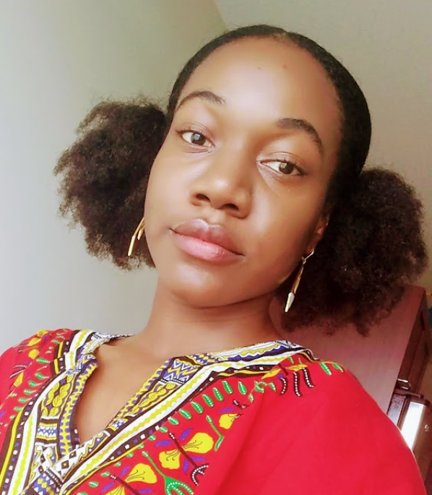

People to contact
Want to present a session? Contact Emiko at ejmuraki@ucalgary.ca or on Slack @Emiko
Have a complaint/bad experience? Contact Jenelle at jenelle.morgan@ucalgary.ca or on Slack @Jenelle Morgan
Other questions/comments? Contact Gwen at gwen.vanderwijk@ucalgary.ca or on Slack @Gwen
Notes:
~ 40 sec

Slide 16
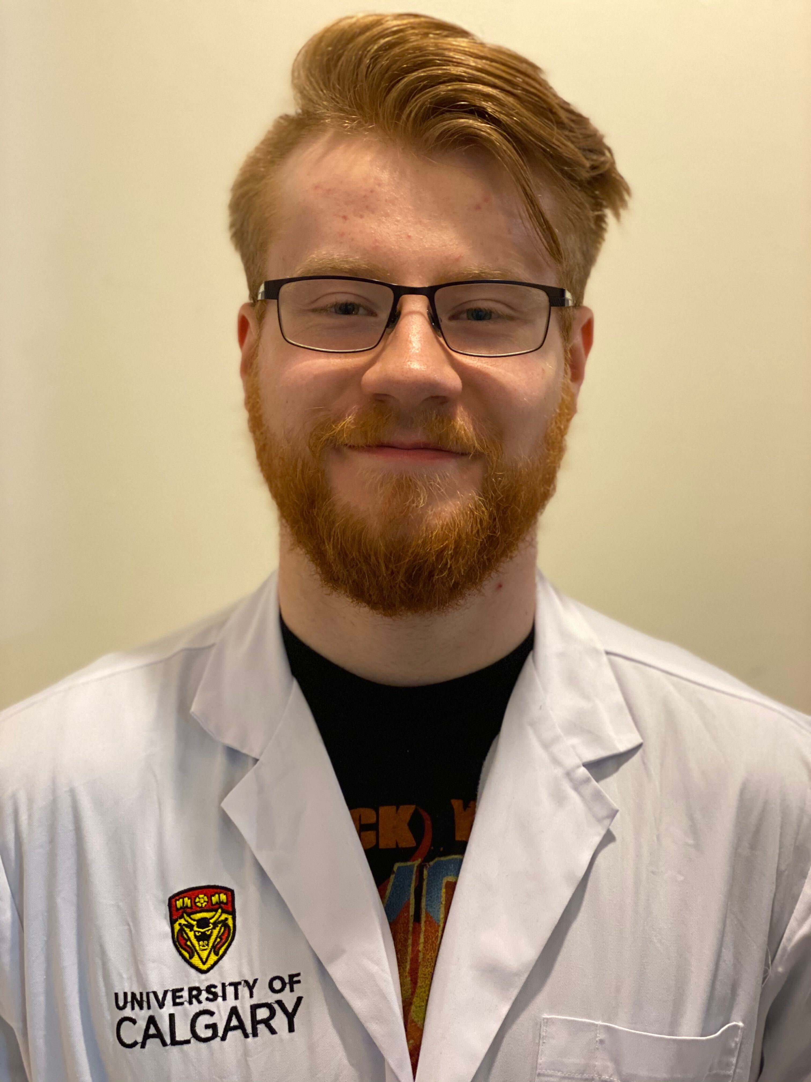
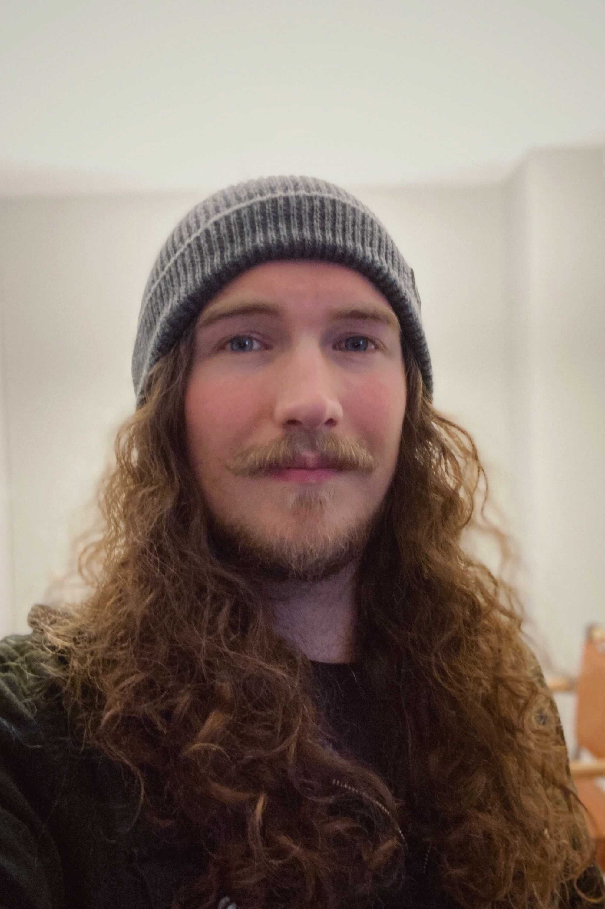
Online platforms
Teams/Sharepoint (view page – join group)
Basic info on our group → sharing
OSF (view our page – get started)
Popular platform for open science projects (cooperation, sharing data/articles)
GitHub (view our page – get started)
Sharing code/open source software
Slack (join our workspace – get help)
Communication within group
Run into technical issues? Contact Matt/Michael
matthew.dawson@ucalgary.ca michael.mccarthy@ucalgary.ca @Matt Dawson @Michael
Sharepoint/OSF/GitHub Slack/OSF/GitHub
Notes:
Lastly, a bit more info about the online platforms we are using.
We have an outlook Group and sharepoint for basic information about our group, for people who are just looking for some quick information.
Then we also decided to use different open science tools to organize this group, so that we can all start to get familiar with them. I already briefly talked about OSF, and here is the link to our project page and a guide on how to get started.
Then we are also using GitHub, which is a popular platform for sharing and collaborating on code and open source software. Once again see the link to our page and a guide.
Lastly, we are using Slack for internal communication, also because it allows integration with many open science tools, such as Github.
~ 55 sec

Slide 17
References
Allen, C. & Mehler, DMA. (2019). Open science challenges, benefits and tips in early career and beyond. PLoS Biol 17(5): e3000246. https:// doi.org/10.1371/journal.pbio.3000246
Amrhein, V., Greenland, S., & McShane, B. (2019). Scientists rise up against statistical significance.
Bahlai, C., Bartlett, L. J., Burgio, K. R., Fournier, A., Keiser, C. N., Poisot, T., & Whitney, K. S. (2019). Open science isn’t always open to all scientists. American Scientist, 107(2), 78-82.
Bumpus, N. (2020). Too many senior white academics still resist recognizing racism. Nature, 583(7818), 661-661.
Joober, R., Schmitz, N., Annable, L., & Boksa, P. (2012). Publication bias: what are the challenges and can they be overcome?. Journal of psychiatry & neuroscience: JPN, 37(3), 149.
Larivière, V., Haustein, S., & Mongeon, P. (2015). The oligopoly of academic publishers in the digital era. PloS one, 10(6), e0127502.
Nosek, B. A., Aarts, A. A., Anderson, J. E., Kappes, H. B., & Open Science Collaboration. (2015). Estimating the reproducibility of psychological science. Science, 349(6251), aac4716-aac4716.
Nuijten, M. B., Hartgerink, C. H., van Assen, M. A., Epskamp, S., & Wicherts, J. M. (2016). The prevalence of statistical reporting errors in psychology (1985–2013). Behavior research methods, 48(4), 1205-1226.
Piwowar, H., Priem, J., Larivière, V., Alperin, J. P., Matthias, L., Norlander, B., ... & Haustein, S. (2018). The state of OA: a large-scale analysis of the prevalence and impact of Open Access articles. PeerJ, 6, e4375.
Tennant, J [DARIAH-EU]. (2018, June 1). Open Science is just good science [Video]. Youtube. https://www.youtube.com/watch?v=UEEcwRUgQu8&feature=emb_title. [Talk delivered at the Oxford University Seminar on Reproducibility and Open Research. http://users.ox.ac.uk/~phys1213/ReproAtASC.html]
Wellmon, C., & Piper, A. (2017). Publication, power, and patronage: On inequality and academic publishing. Critical Inquiry, 21.

Slide 18
Resources
Listen (podcasts):
Open science talks: What is open science? (~15 minutes)
Radiolab: Stereothreat (~40 min)
Research Matters: Embracing an open science mindset (~60 min)
The black goat: It’s so complicated (~70 min)
Watch (videos):
Ted Talk about current research culture and open science as a solution: Research Culture is Broken: Open Science can Fix It (~15 min)
Lecture on open science: Open Science is just good science (~40 min)
Webinar on open science by Brian Nosek, Executive Director and Co-Founder of Center for Open Science (COS): Open Science (~60 min)

Slide 19
Resources
Read (articles/papers):
Bahlai, C., Bartlett, L. J., Burgio, K. R., Fournier, A., Keiser, C. N., Poisot, T., & Whitney, K. S. (2019). Open science isn’t always open to all scientists. American Scientist, 107(2), 78-82.
Kathawalla, U., Silverstein, P., & Syed, M. (2020, May 8). Easing Into Open Science: A Guide for Graduate Students and Their Advisors. https://doi.org/10.31234/osf.io/vzjdp
Monbiot, G. (2011). Academic publishers make Murdoch look like a socialist. The Guardian, 29, 8. http://wavelets.ens.fr/BOYCOTT_ELSEVIER/ARTICLES/2011_08_29_The_Guardian.pdf
Blogpost + discussion: The grad student who never said ‘no’
Great overview of more resources presented in a tiered way so you can select what you have time for: A Guide for Open Science for People Who Are Already Too Busy
More resources, tutorials and step-by-step guides on open science practices: https://osf.io/w5mbp/wiki/home/
Notes:
Link to slides: https://osf.io/yxmfj/

